Slide 1
Event Attribution and how to do it
Fraser Lott, Peter Stott
Exeter Maths School, 17th January 2020

Slide 2
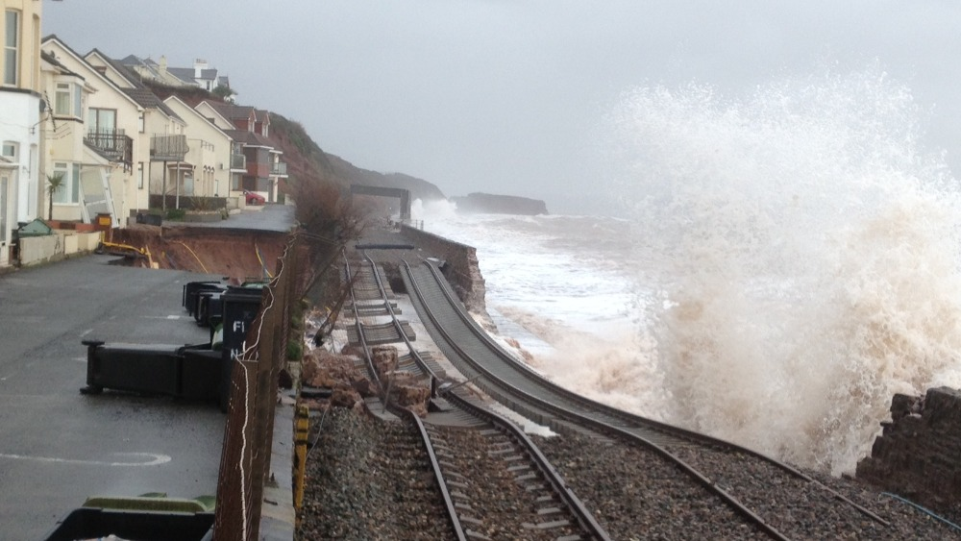
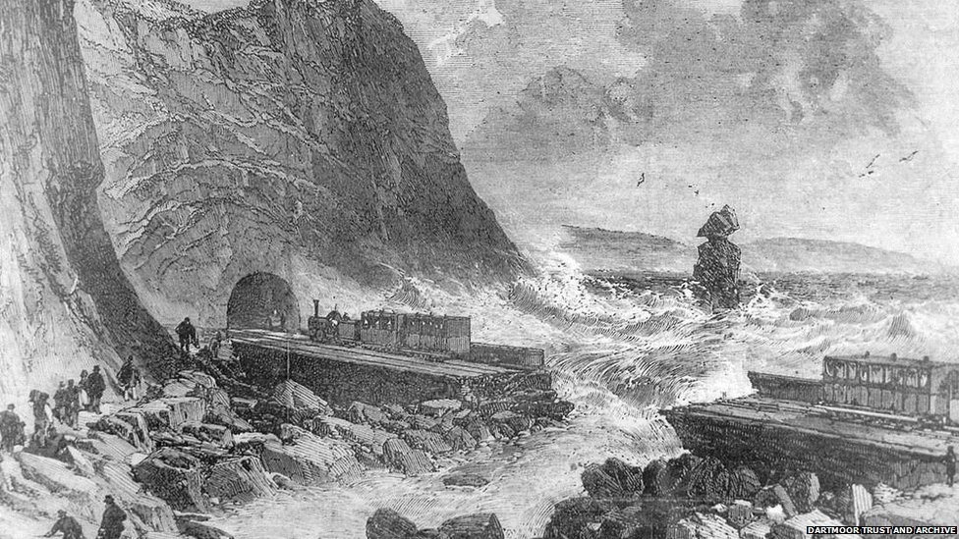
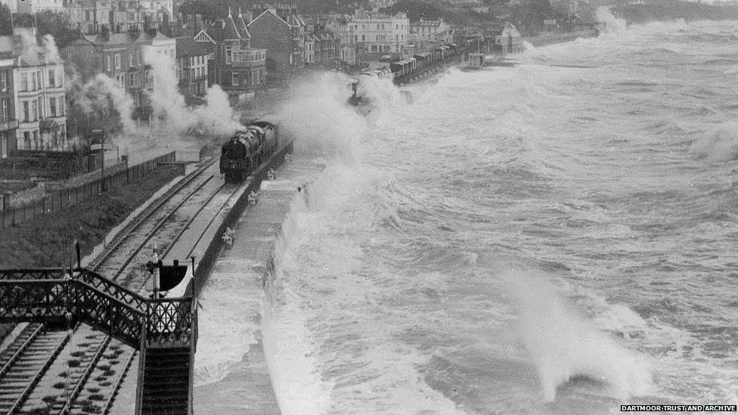
Was this event climate change?
The press didn’t know that we hadn’t yet invented what they were asking for. Until 2003, we usually replied, “Climate change can’t be seen in individual events.” There are still some who say all/no events are caused by climate change…

Slide 3
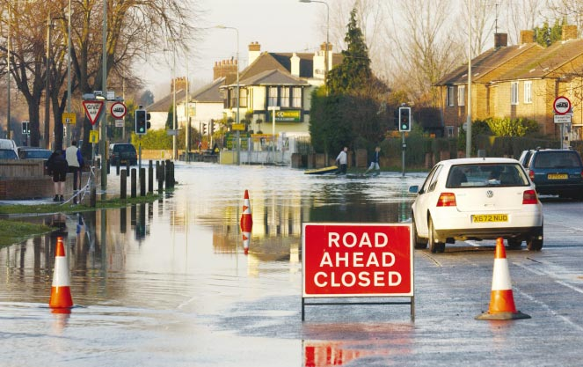
Who can I sue?
…in which Myles Allen’s house almost gets flooded, so he invents event attribution
(Allen 2003, Nature 421 p891-892) …
It is often assumed that individual weather events cannot be ascribed to climate change
However, climate change may change the probability of that event having taken place

Slide 4
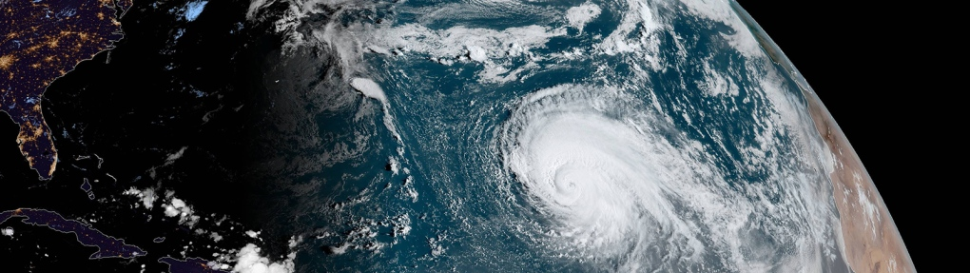
Butterflies and Hurricanes
NOAA
There are some equations which, when you change one variable by a tiny amount, give a vastly different answer. The name for this branch of mathematics is Chaos.
The physics behind the weather is chaotic. It’s said that if a butterfly flaps its wings in West Africa, it can cause a hurricane off the coast of Florida.

Slide 5
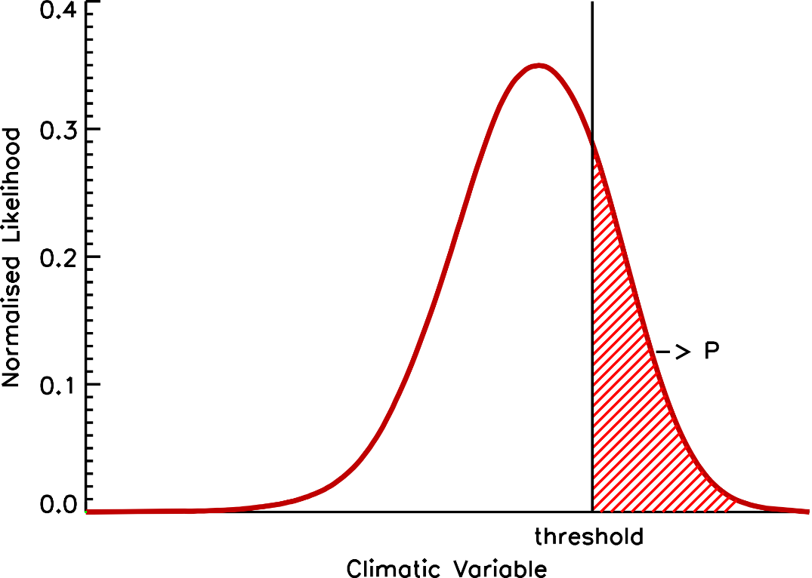
A range of weather
The climate is the range of weather that chaos can produce.
Some of that weather will be as bad or worse than what we observed.
By plotting a histogram, we can see how probable that would be.

Slide 6
How do we define an event?
P: Probability of an event as bad or worse than we saw in the real world.
At the Met Office, we simulate the real climate, and we can use Chaos to get different weather each time we run the simulation.

Slide 7
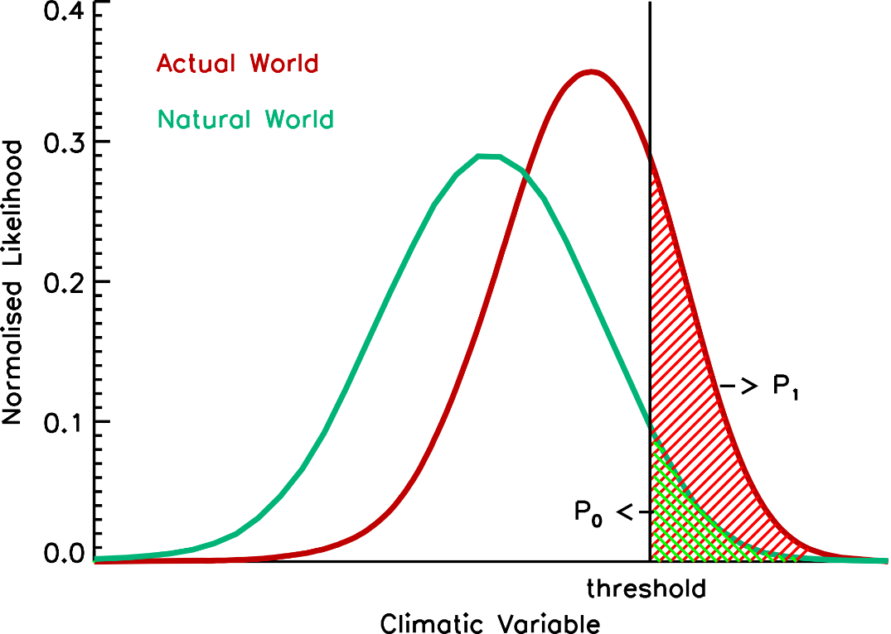
Was the natural climate different?
P₀: Probability of the event in a simulated “natural world” (no human influence on the climate).
P₁: Probability of the event in the real world.
Risk Ratio = P₁ / P₀
This shows the event was this many times more likely

Slide 8
What events are we studying?

Slide 9
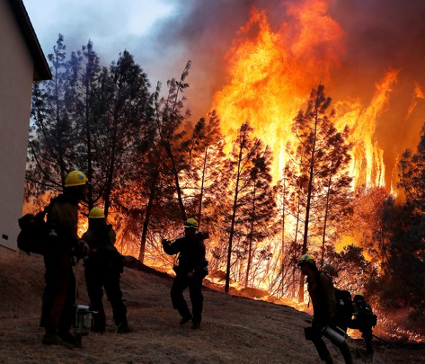
Western North America, July 2018
In summer 2018, there were huge wildfires in California. Were these entirely natural?
One project will look at whether the temperatures in Western North America were unusual, and whether human emissions have changed them.
Stephen Lam / Reuters

Slide 10
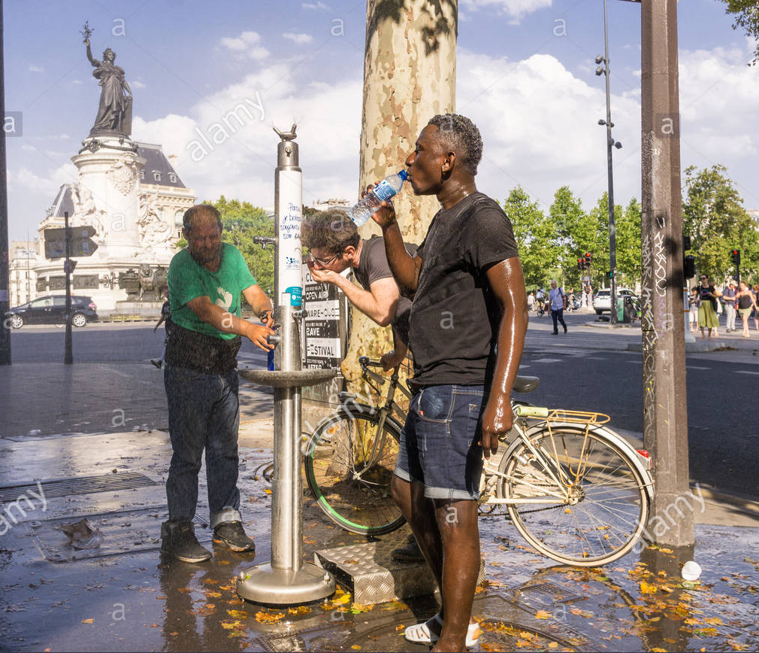
The Mediterranean, June 2019
Last summer, there were two heatwaves in Europe, the first of which broke records all over the south of France.
This project will look at how extreme temperatures were around the Mediterranean, and whether we have affected them.

Slide 11
What data are you getting?
Excel files with:
The observed mean temperature for the region and month of the event you are studying, between 1961 and 1990
The observed temperature anomaly (the measured difference from the long-term mean) in the event year
525 simulated real-world temperature anomalies
525 simulated natural-world temperature anomalies

Slide 12
Summary
We can look at simulations of extreme weather events to see whether they get more or less likely with climate change.
Plot histograms of the data we’ve given you and work out the probabilities in the real and natural worlds.
If you need more data, just ask!
Notes:
The sub-selection within that year pool will add skill to the data. This probably also applies to analogues etc. It’s not yet clear whether this will result in a perfect reliability though – it’s likely that some further calibration would be necessary.

Slide 13
Thanks for listening. Any questions?

